Slide 1

VisualRWKV
(RwaKuv)
Exploring Recurrent Neural Networks for Visual Language Models
Speaker：侯皓文 博士/副研究员
光明实验室
Date：2025/2/22

Slide 2
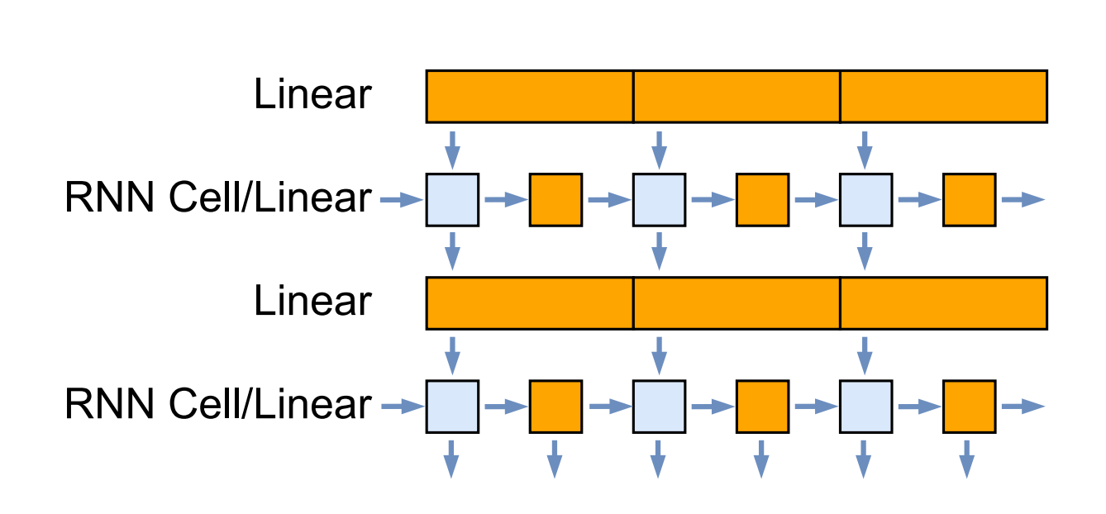
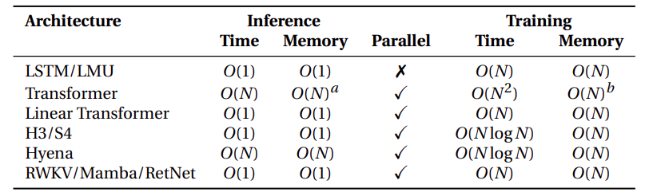
Background of RWKV
Introduction
RNN
The limitations of RNNs and Transformers
The basic form of RNN is
RNN has the vanishing gradient problem.
RNN cannot perform parallel training, limiting its scalability.
Transformer has quadratic time and space complexity, resulting in high computational costs and memory usage
ht = α_{t} ⊙ h_{t−1} + (1 − α_{t}) ⊙ x_{t}
RNN processes step by step, handling only one character or word at a time.
low memory and computational cost.
Its dependence on previous steps prevents parallel training, limiting scalability.
RWKV is a new-generation RNN
In contrast, Transformer handles sequences in parallel
RWKV can be trained in parallel and has strong scalability.
The time and space complexity of RWKV during training is O(N).
The time and space complexity of RWKV during inference is O(1).
The RNN architecture
Time Complexity and Space Complexity

Slide 3
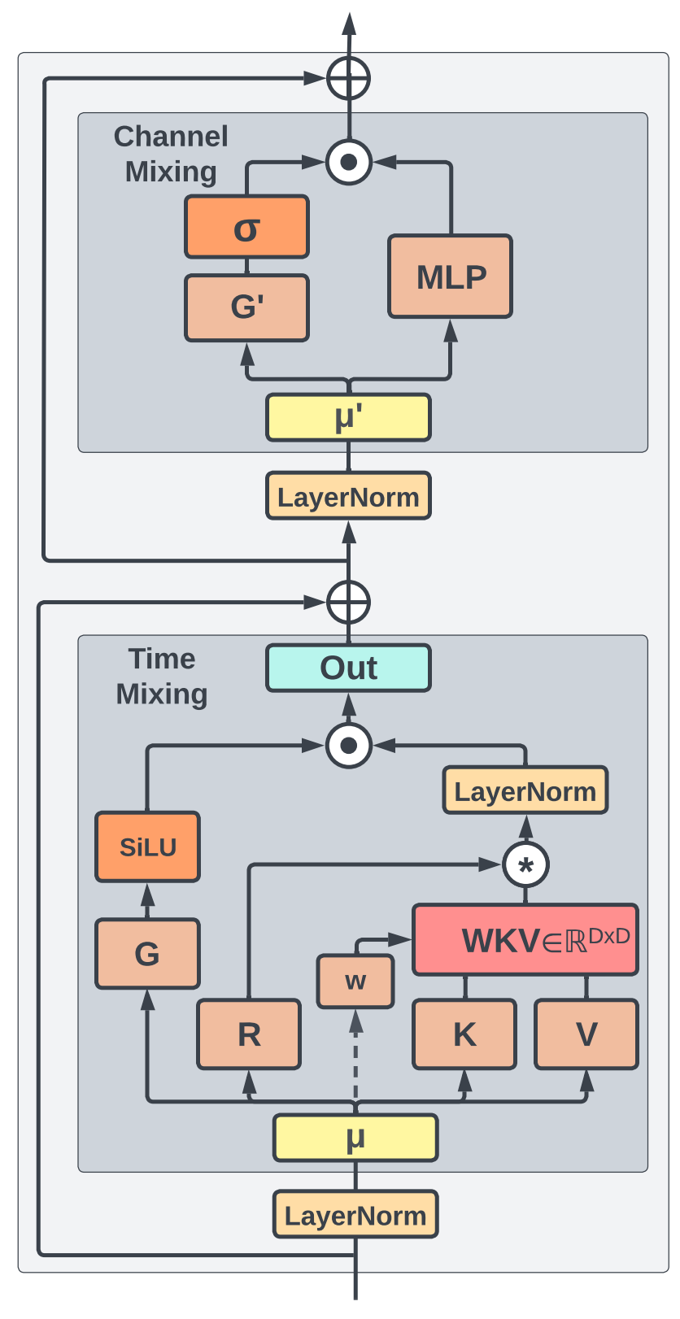
RWKV Architecture
The origin of the name RWKV
Receptance
Value
As a receptive vector for past information.
R
V
Similar to the Value vector in traditional attention.
RWKV Block
Weight
W
K
Key
position-weighted decay vector
Similar to the Key vector in traditional attention.
WKV is a concept corresponding to QKV

Slide 4
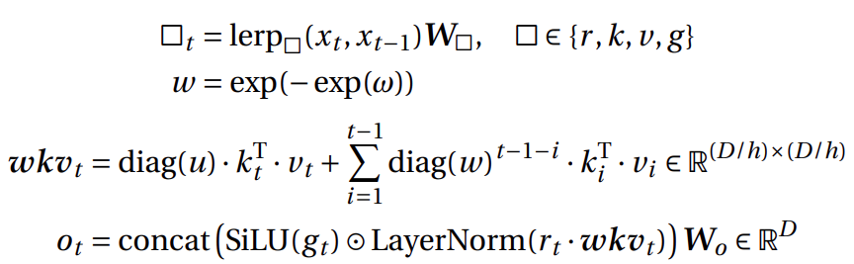
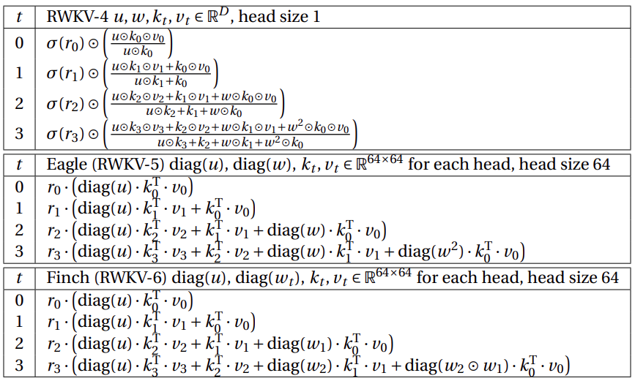
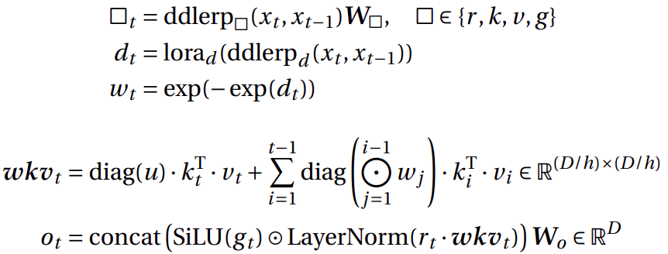
RWKV Time Mixing
Evolution of Time Mixing
RWKV-5 time-mixing
Evolution of time-mixing from RWKV- 4 to RWKV- 6
RWKV-5 remove the normalization term.
RWKV-5 introduce hidden state matrix, from vector to matrix
RWKV-6 time-mixing
RWKV-6 introduction channel-wise weight decay w_{t}

Slide 5
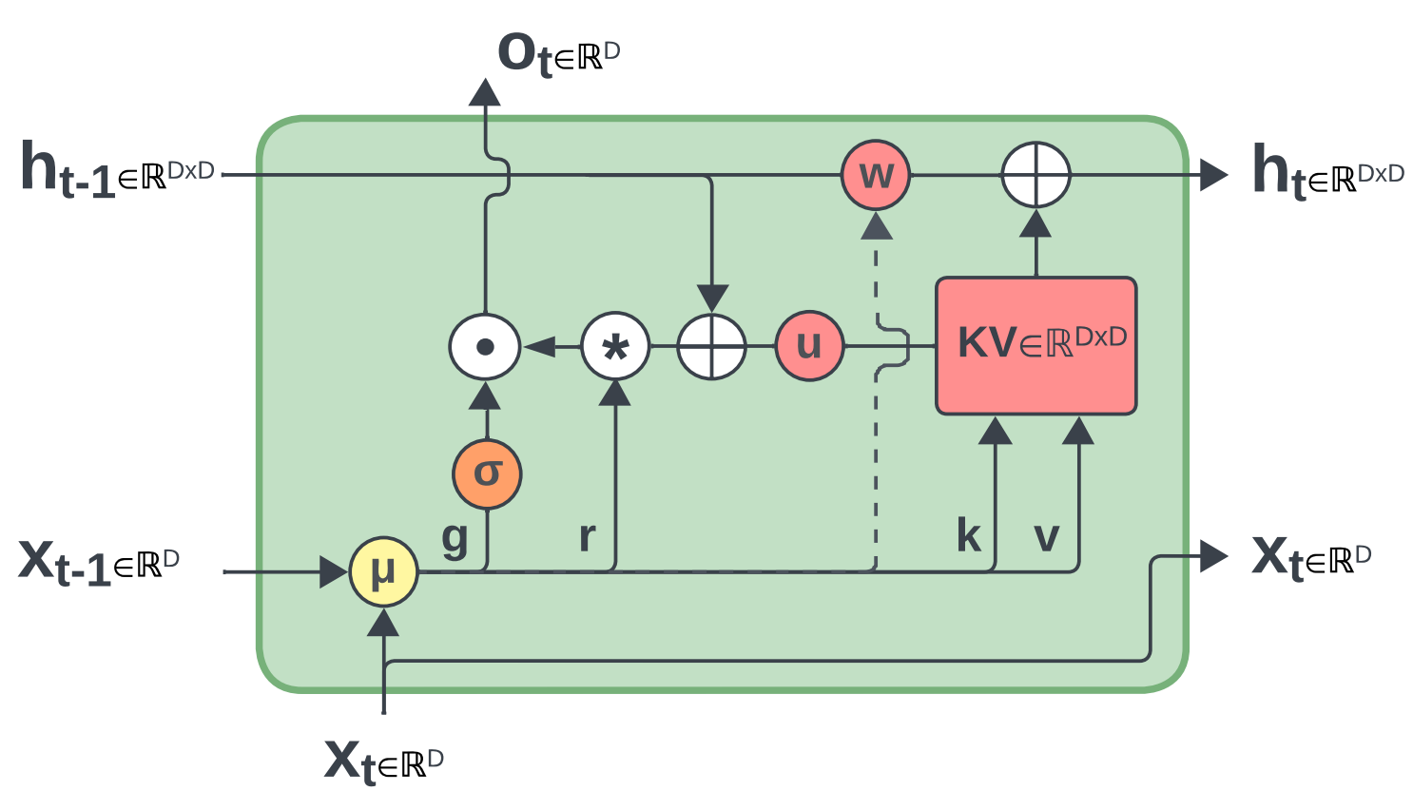
The RNN perspective of RWKV
RWKV as RNN cell
Recurrent form of RWKV5/ 6 :
code:
# r, k, v parameter shape (B,H,1,D//H)
# w parameter of shape (1,H,1,D//H) for Eagle (RWKV-5),
# (B,H,1,D//H) for Finch (RWKV-6)
# u parameter of shape (1,H,1,D//H)
def rwkv_5_or_6_recurrent(r, k, v, w, u, wkv_state):
kv = k.mT @ v # x.mT is equivalent to x.transpose(-2, -1)
out = r @ (wkv_state + u.mT * kv)
wkv_state = w.mT * wkv_state + kv # (B,H,D//H,D//H)
return out, wkv_state
RWKV- 5: Replaces the static decay rate in RetNet with a learned channel decay rate.
RWKV-6: Dynamically generates data-dependent token-shift amounts and decay rates.

Slide 6
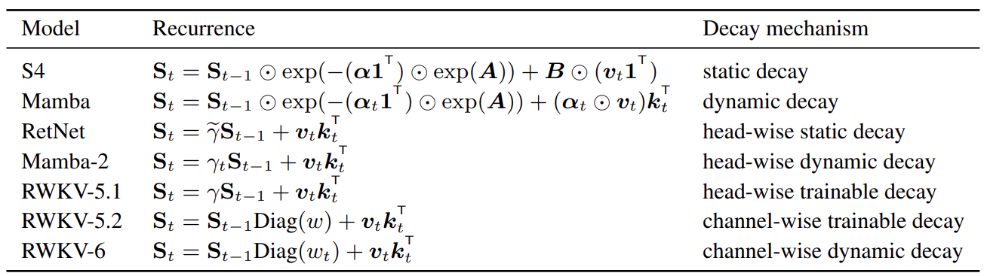
Comparison of RWKV with other architectures
Comparison of the core formula of Time-Mixing
The recently proposed linear attention/ RNN architecture
Ref: https://arxiv.org/pdf/2406.06484v1
S4 is static decay, Mamba-1 is dynamic S4. Mamba- 2 is similar to the linear attention approach, with head-wise dynamic decay.
RetNet uses head-wise static decay, and Mamba- 2 may have drawn inspiration from RetNet's design.
RWKV- 6 uses channel-wise dynamic decay, which is the design with best expressiveness.

Slide 7
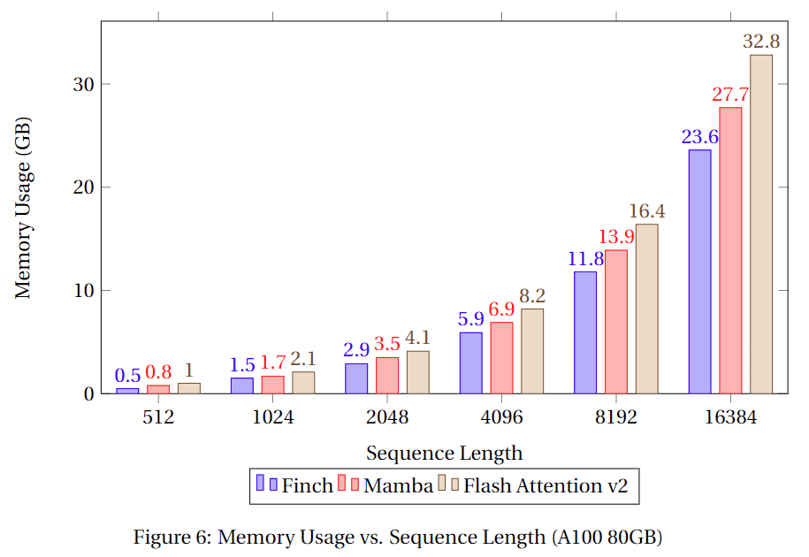
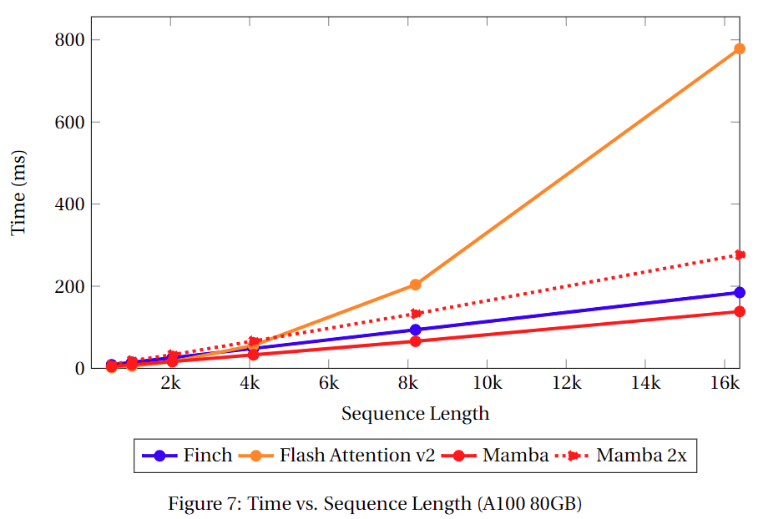
Evaluation of speed and memory usage
Comparison of Mamba-2 and Flash Attention
The batch size is 8, the model dimension is 4096, and the head size for both Flash Attention and RWKV-6 is set to 64
RWKV-6 surpasses Flash Attention in speed and outperforms both Mamba-2 and Flash Attention-v2 in memory efficiency
Notes:
Pytorch / 2.1.2 / 3.10(ubuntu22.04) / 11.8

Slide 8
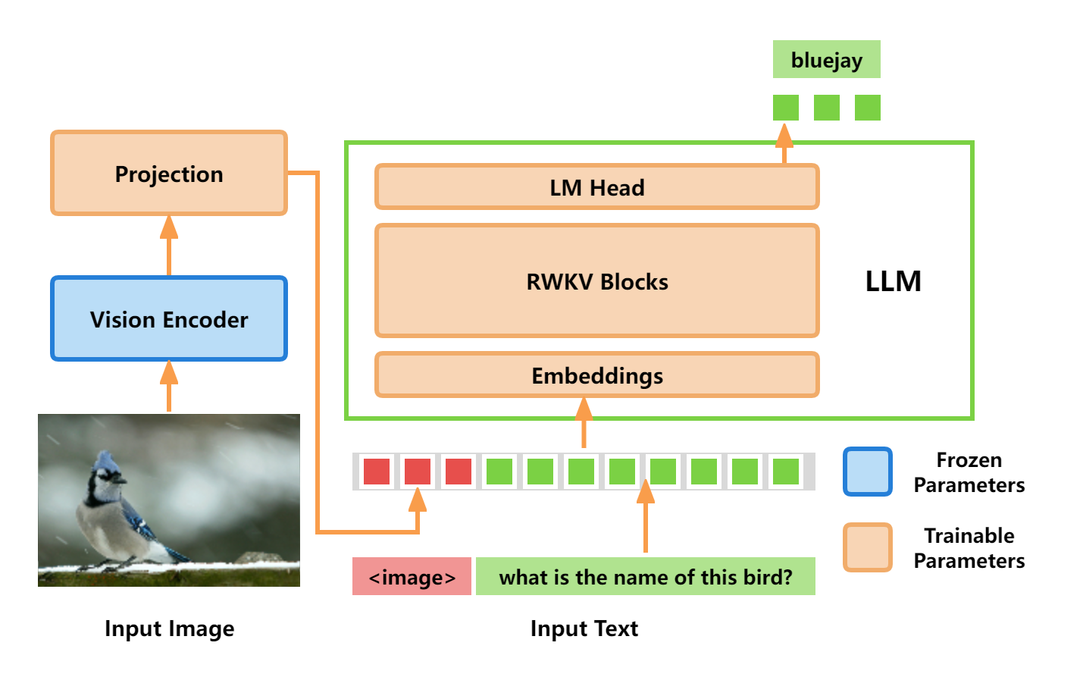
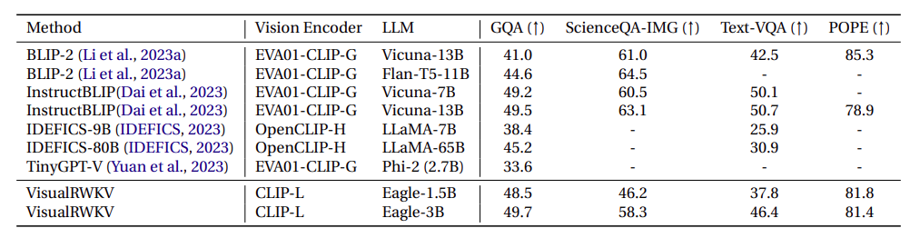
VisualRWKV- 5: Simply imitating Transformer-based VLM does not work
VisualRWKV- 5
CLIP vision encoder + RWKV- 5 LLM
Poor Performance
VisualRWKV- 5 = Data-independent Recurrence + Image First Prompt + Unidirectional Scanning
First bottleneck: model is not strong enough
Second bottleneck: one directional scanning nature of RNN

Slide 9
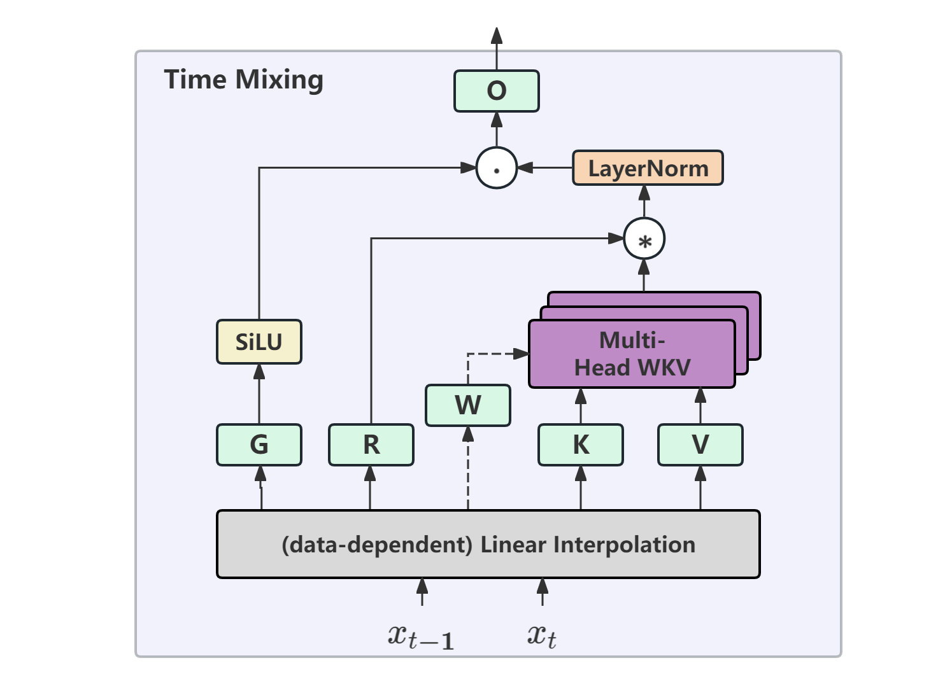
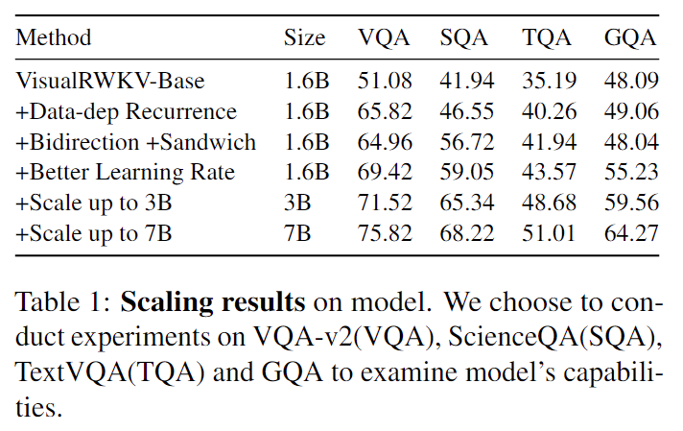
VisualRWKV- 6: Bybond the limitations of Linear RNN
VisualRWKV-6 Visual Language Model
Main Contribution 1: Data-dependent Recurrence
The dashed line represents data-dependent of W
Data-dependent recurrence significantly improves performance,
with VQA showing an increase of nearly 15 points.
Notes:
Pytorch / 2.1.2 / 3.10(ubuntu22.04) / 11.8

Slide 10
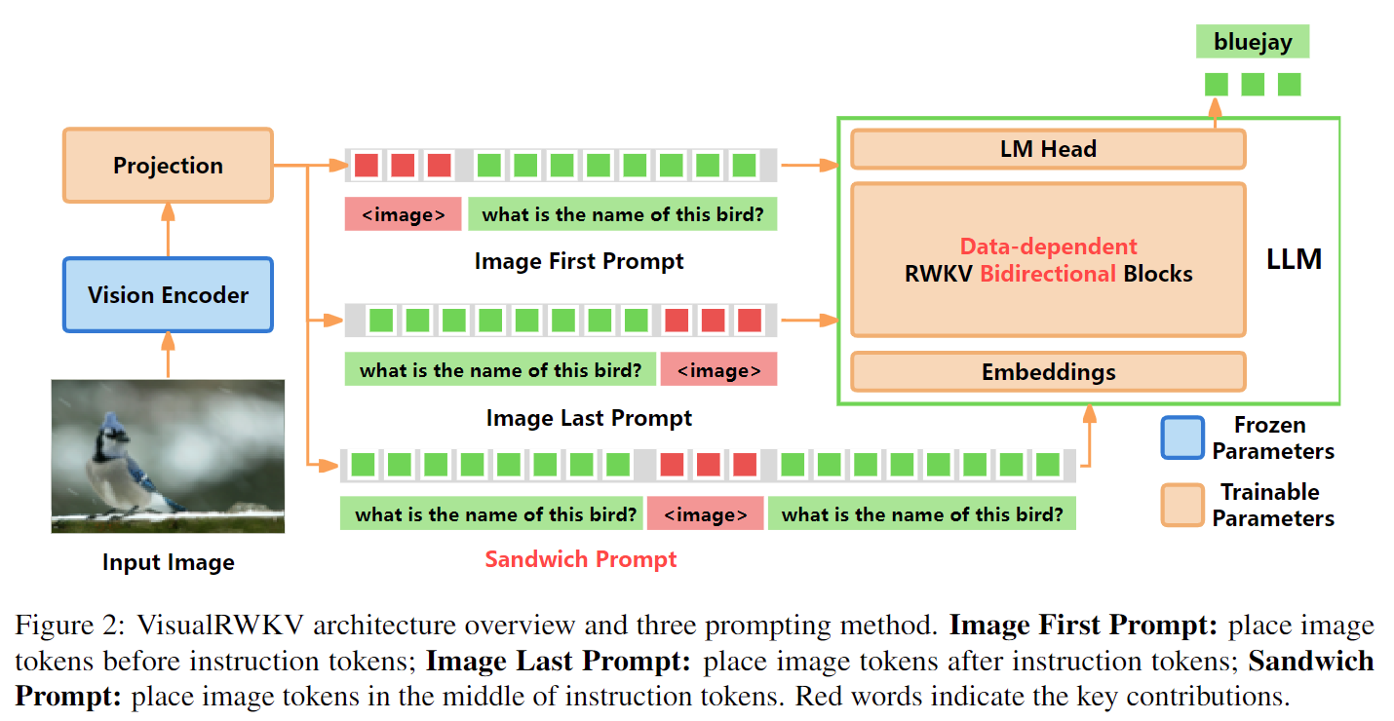
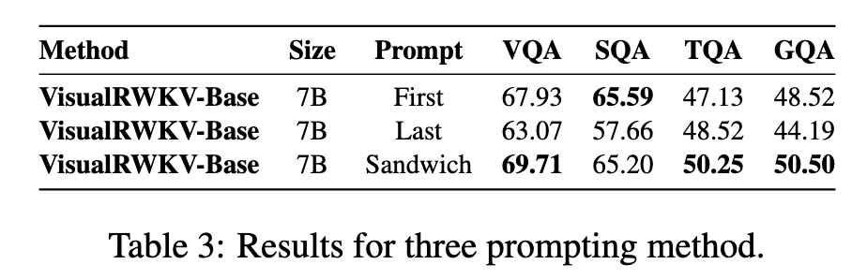
VisualRWKV- 6: Bybond the limitations of Linear RNN
VisualRWKV-6 Visual Language Model
Main Contribution 2: Sandwich Prompt
The sandwich prompt guides the model to first read the question and then find the answer
Notes:
Pytorch / 2.1.2 / 3.10(ubuntu22.04) / 11.8

Slide 11
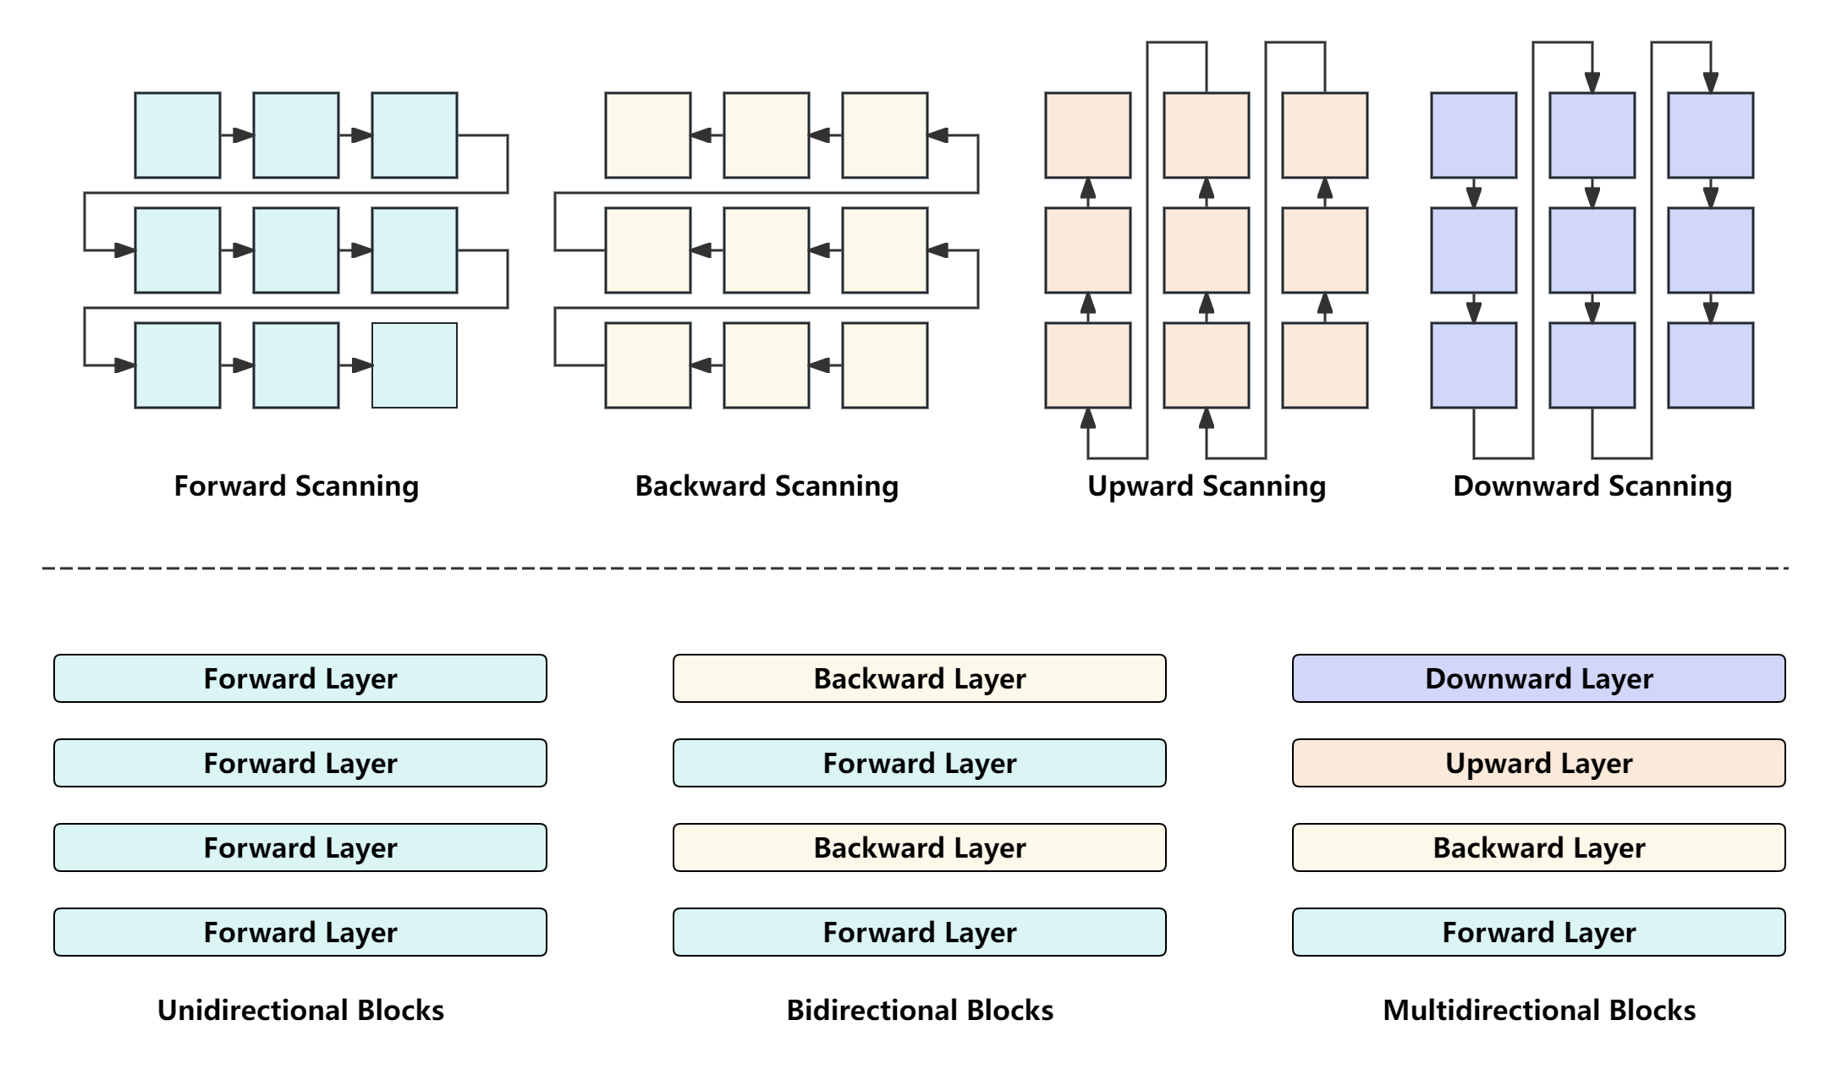
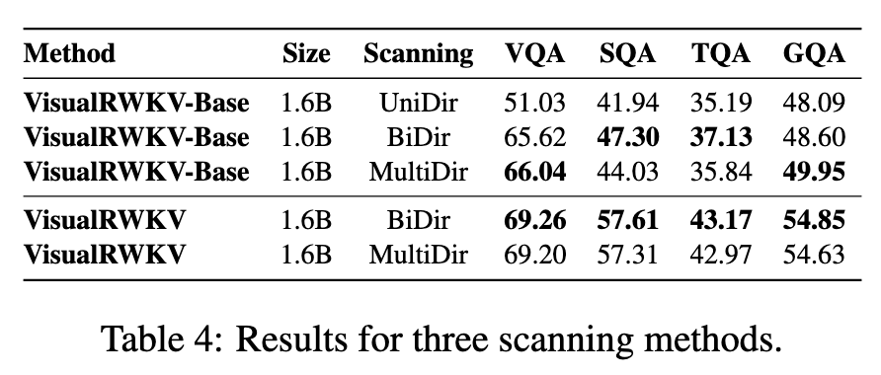
VisualRWKV- 6: Bybond the limitations of Linear RNN
VisualRWKV-6 Visual Language Model
Main Contribution 3: Bidirectional Scanning
Core issue:
Image is two-dimensional information, while Linear RNN performs unidirectional scanning.
Bidirectional and multidirectional scanning are beneficial
Notes:
Pytorch / 2.1.2 / 3.10(ubuntu22.04) / 11.8

Slide 12
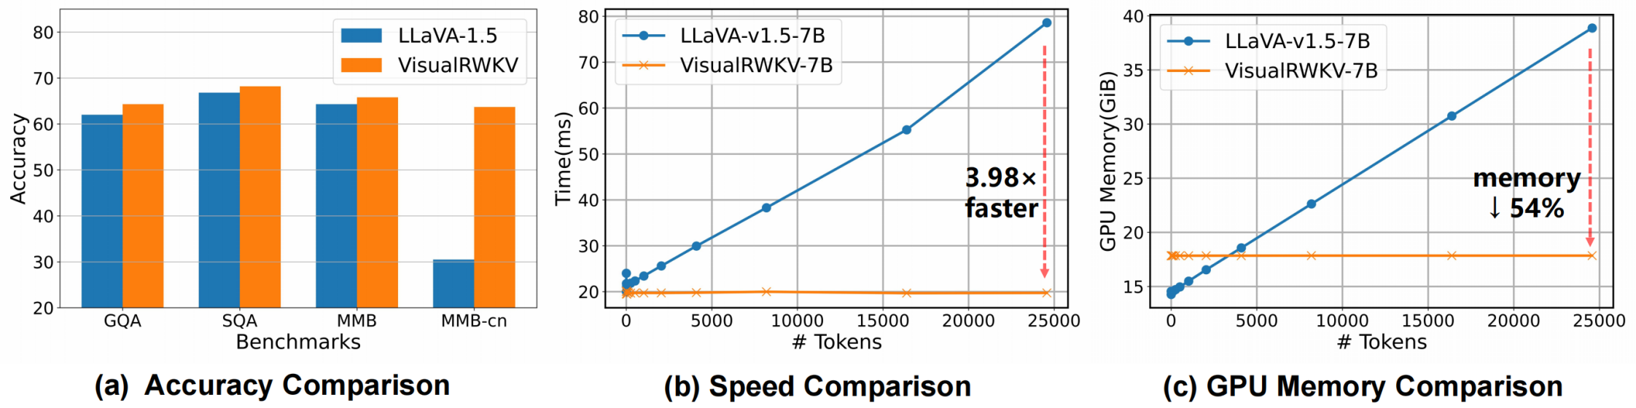
VisualRWKV- 6: Bybond the limitations of Linear RNN
VisualRWKV-6 Visual Language Model
With the integration of Data-dependent Recurrence, Sandwich Prompt, and Bidirectional Scanning, VisualRWKV-6 outperforms LLaVA-1.5 on multiple benchmarks
while maintaining computational efficiency.
Notes:
Pytorch / 2.1.2 / 3.10(ubuntu22.04) / 11.8

Slide 13
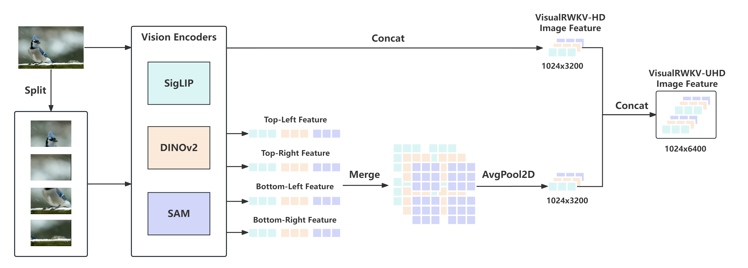
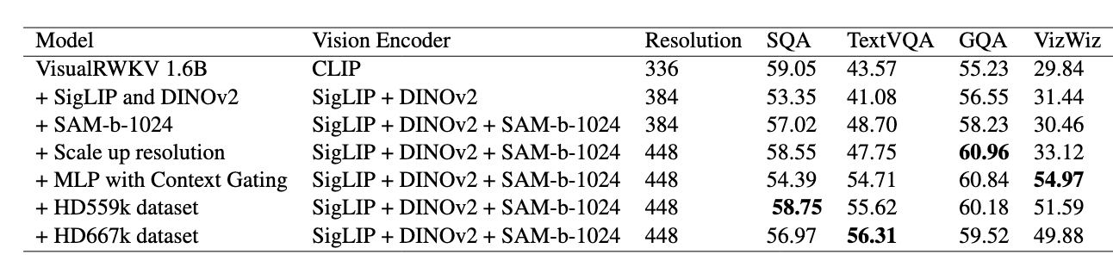
What is Next?
VisualRWKV- HD/ UHD
Multi-Vision Encoders + High Resolution Strategy
TextVQA remains a bottleneck.
The gap caused by the Associate Recall capability.
The introduction of multiple encoders, increased resolution, and high-resolution strategies significantly improves performance on text-rich tasks.
high-quality features can significantly bridge the gap in Associate Recall, Copy, and Retrieve tasks.

Slide 14
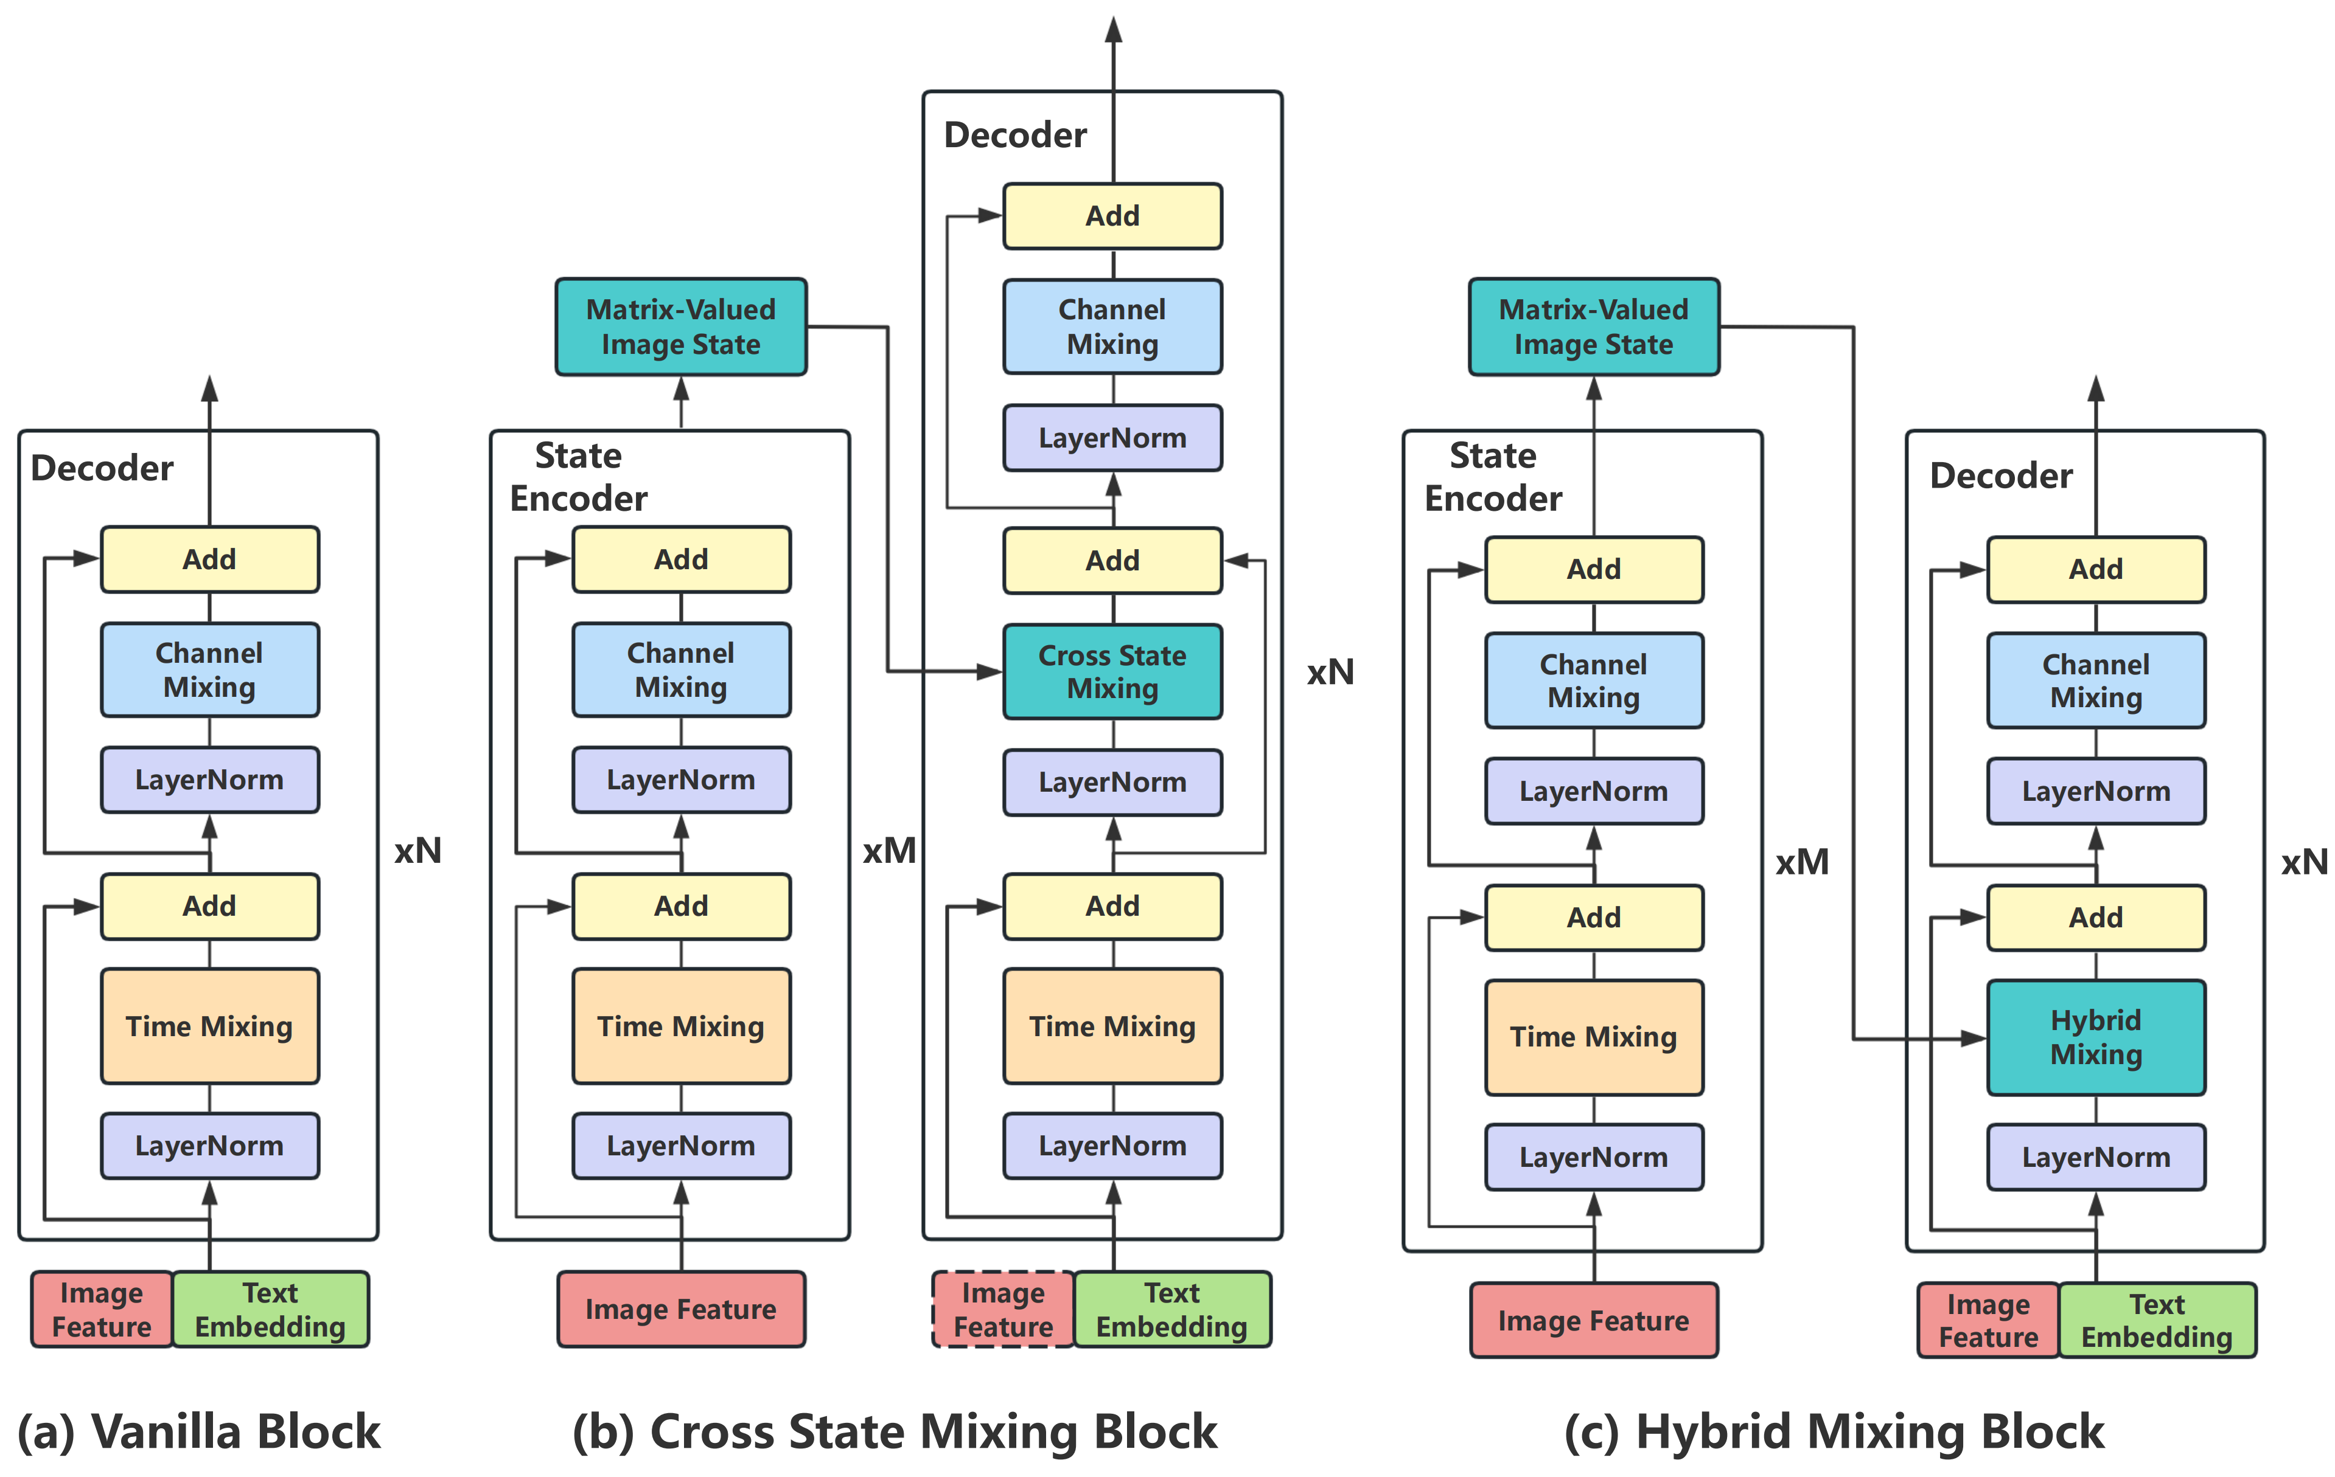
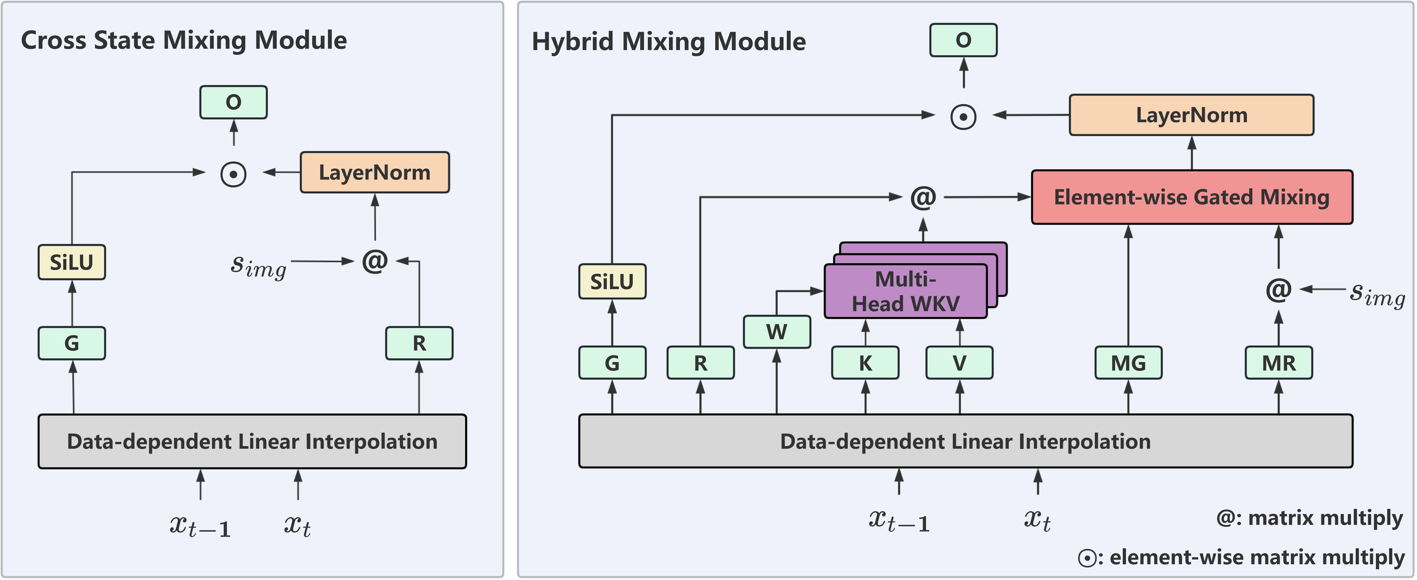
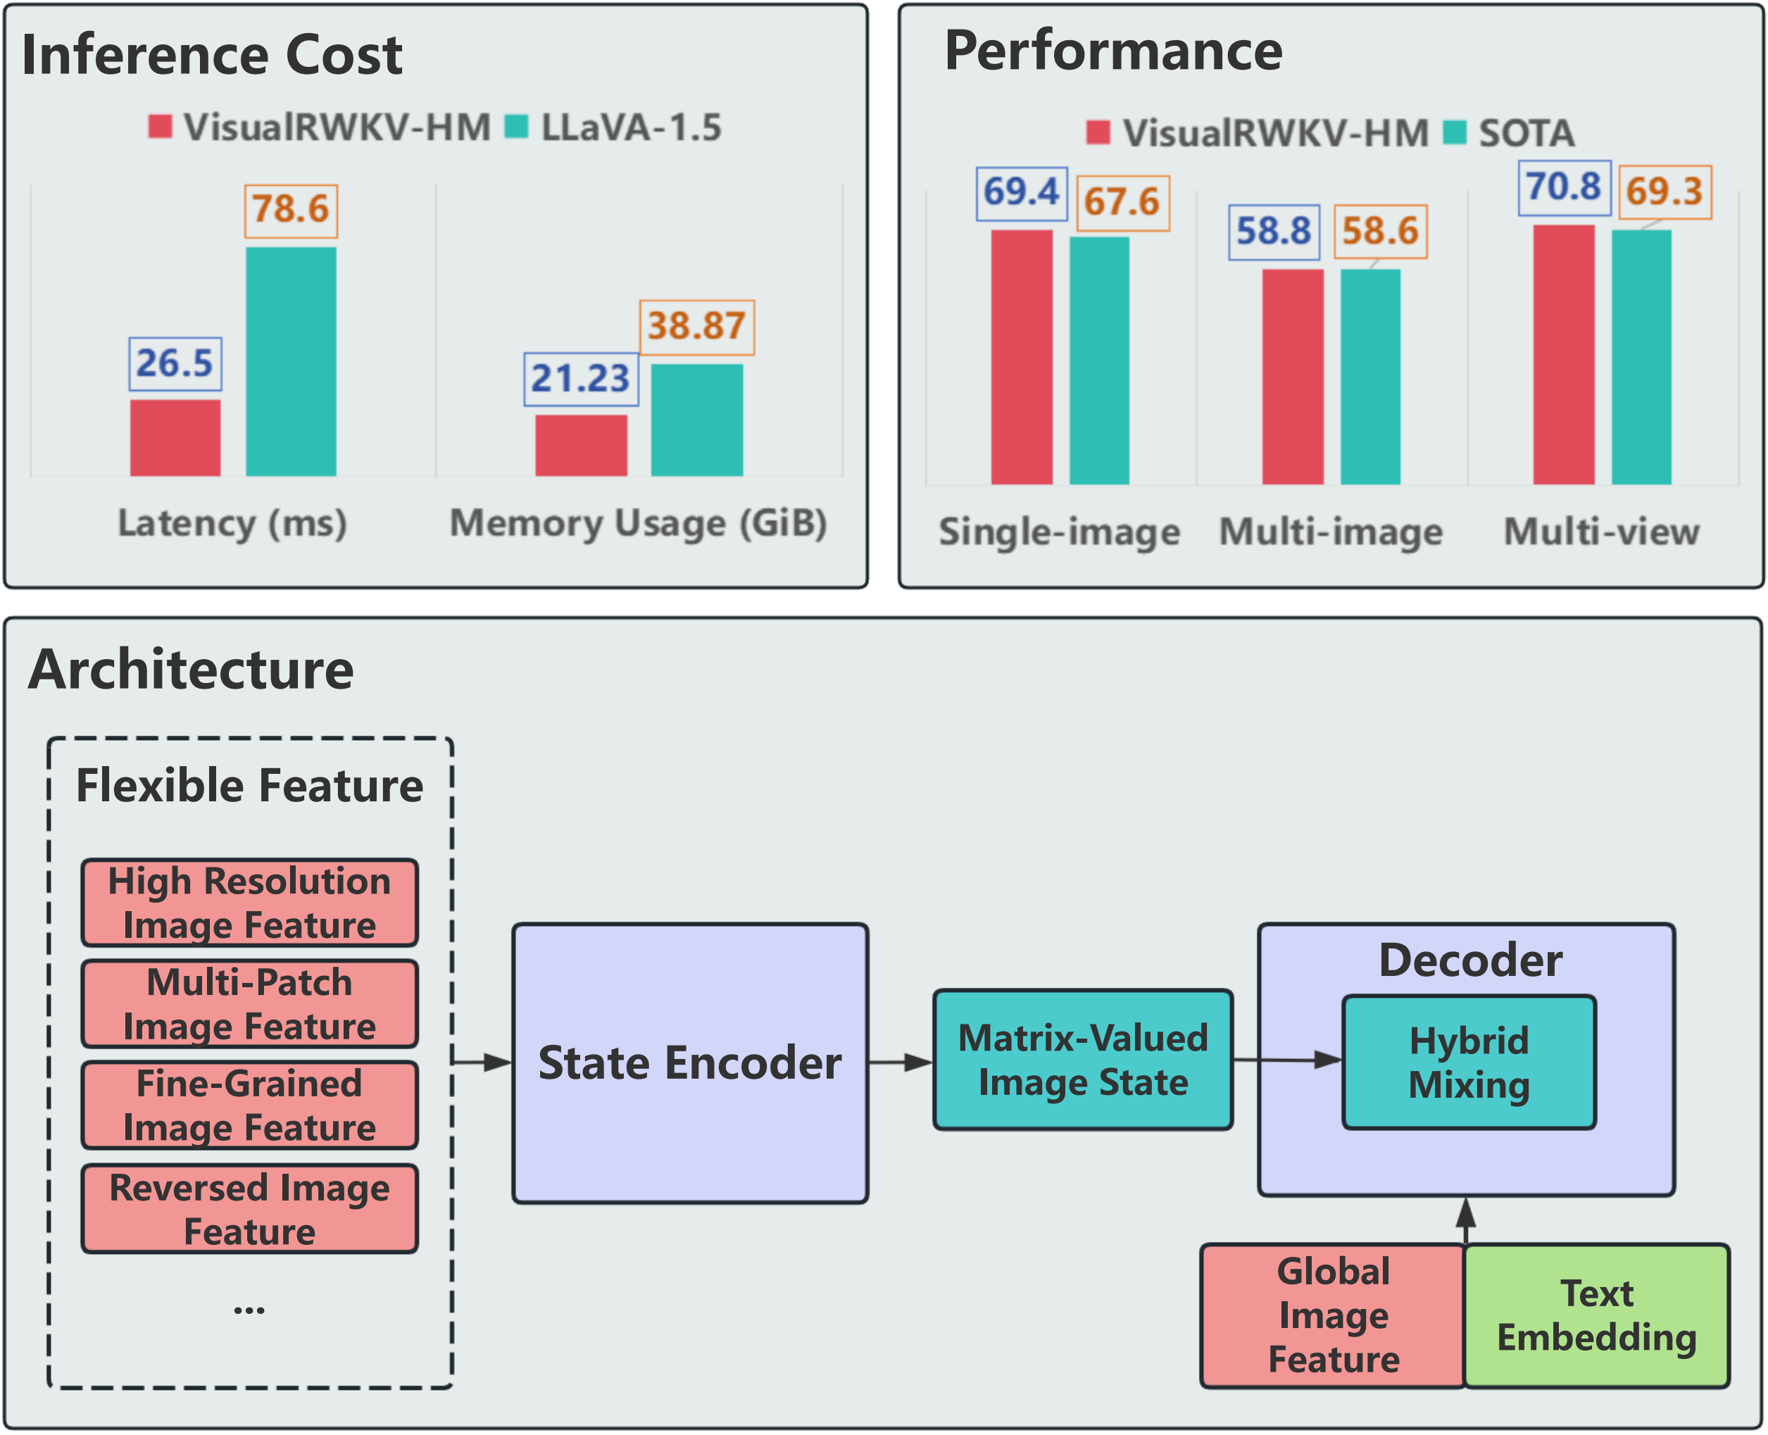
What is Next?
VisualRWKV-HM
Cross State Mixing + Time Mixing = Hybrid Mixing

Slide 15
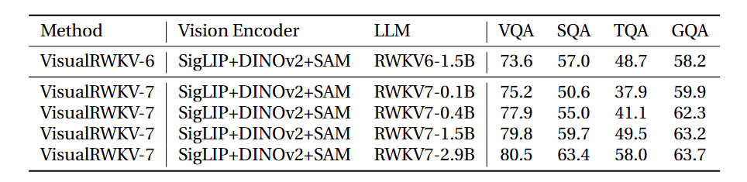
What is Next?
VisualRWKV- 7
Early Results
RWKV Project Page：https://www.rwkv.com/
Discord：https://discord.gg/bDSBUMeFpc
MyEmail: houhaowen@gml.ac.cn
Github: https://github.com/howard-hou/VisualRWKV
X: https://x.com/houhaowen

